Slide 1
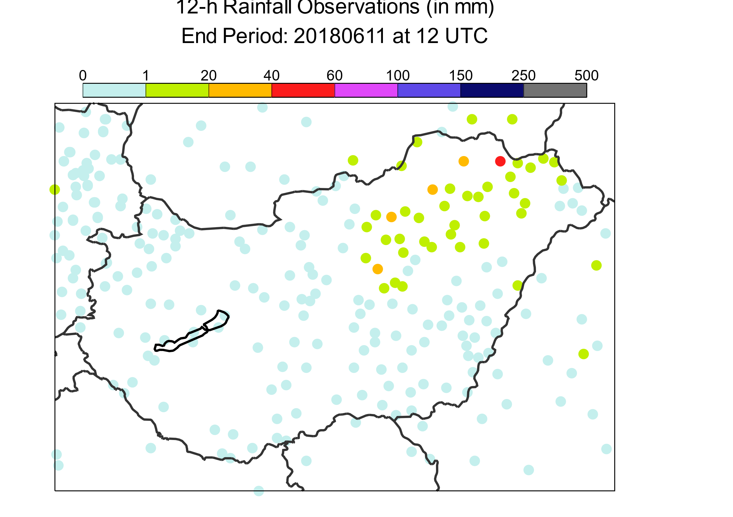
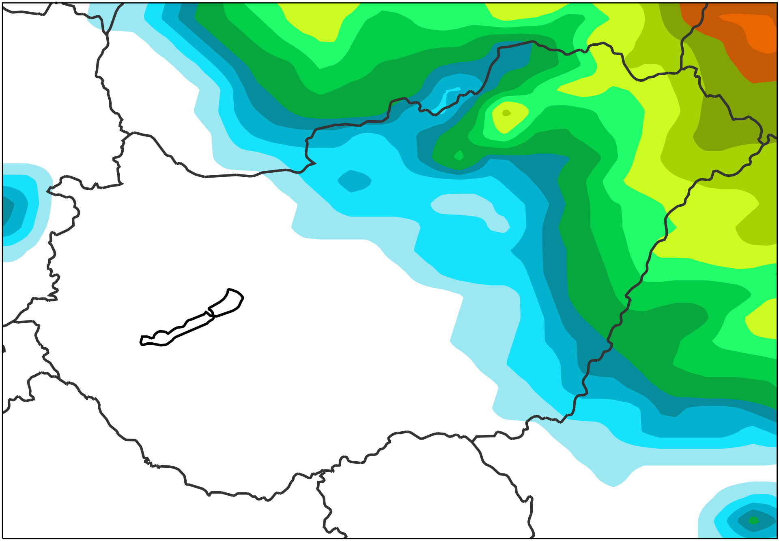
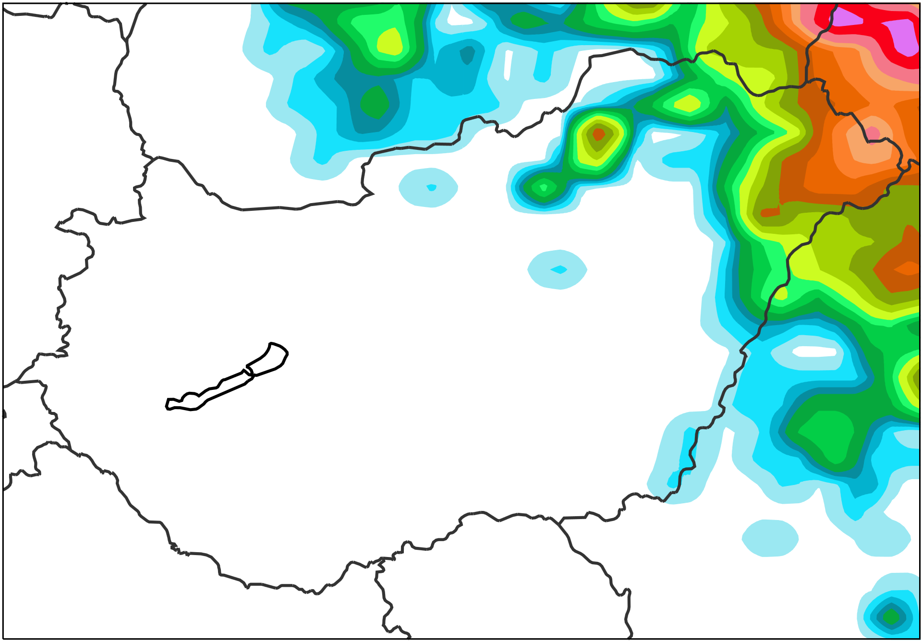
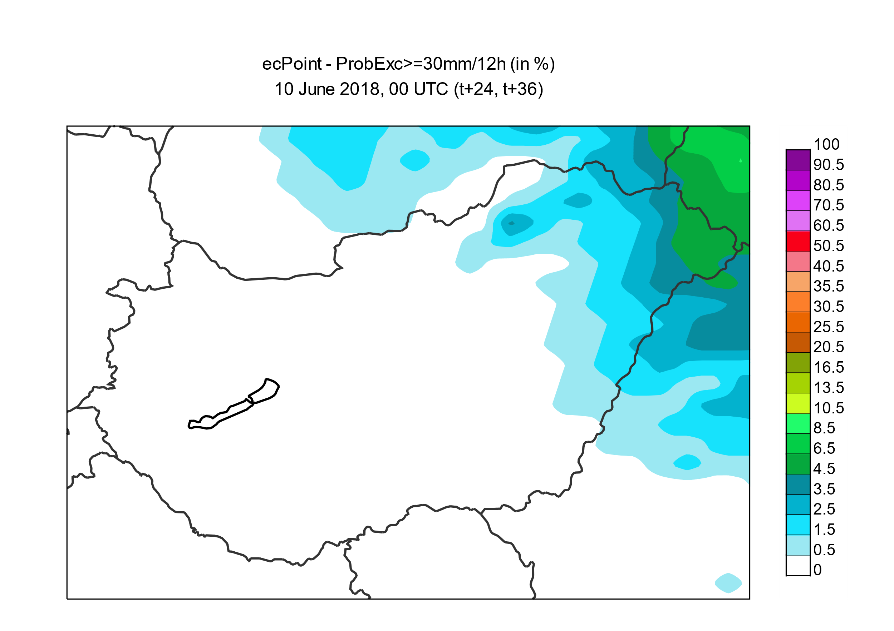
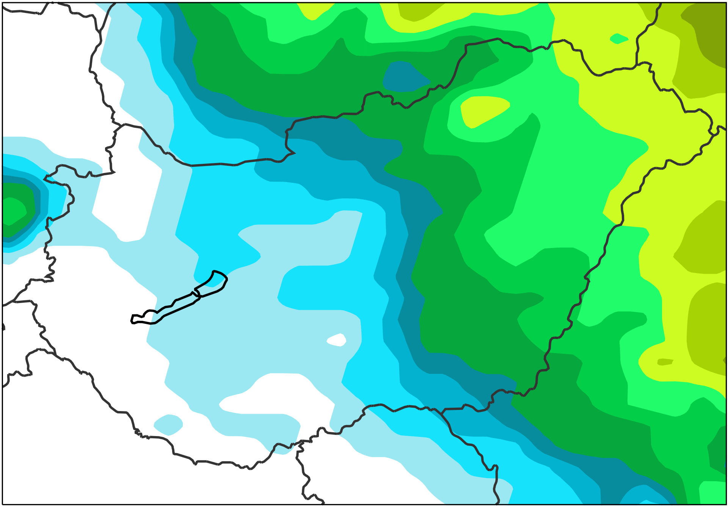
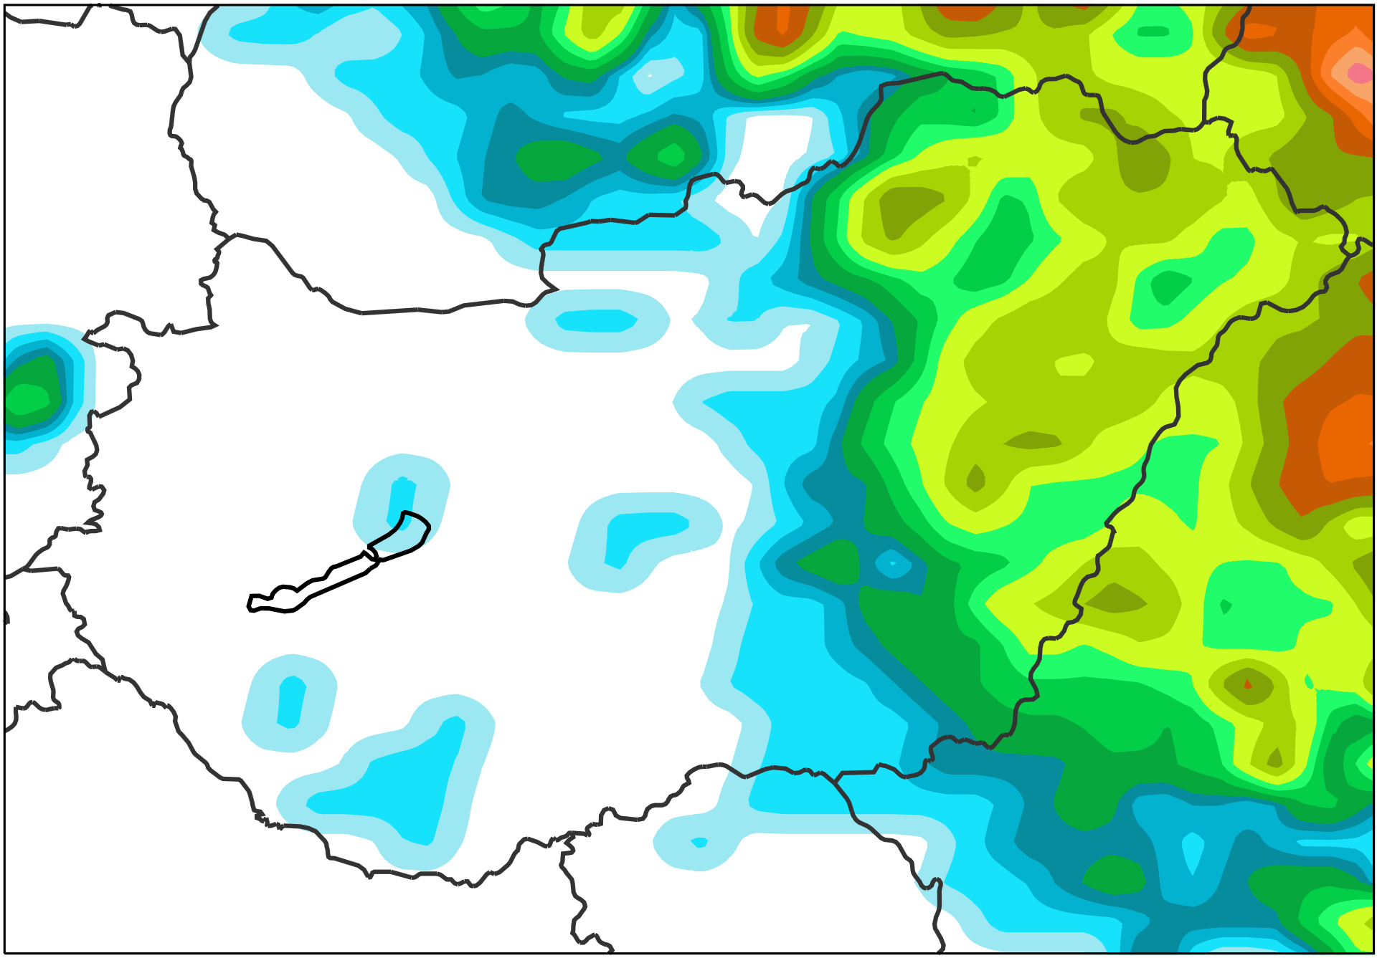
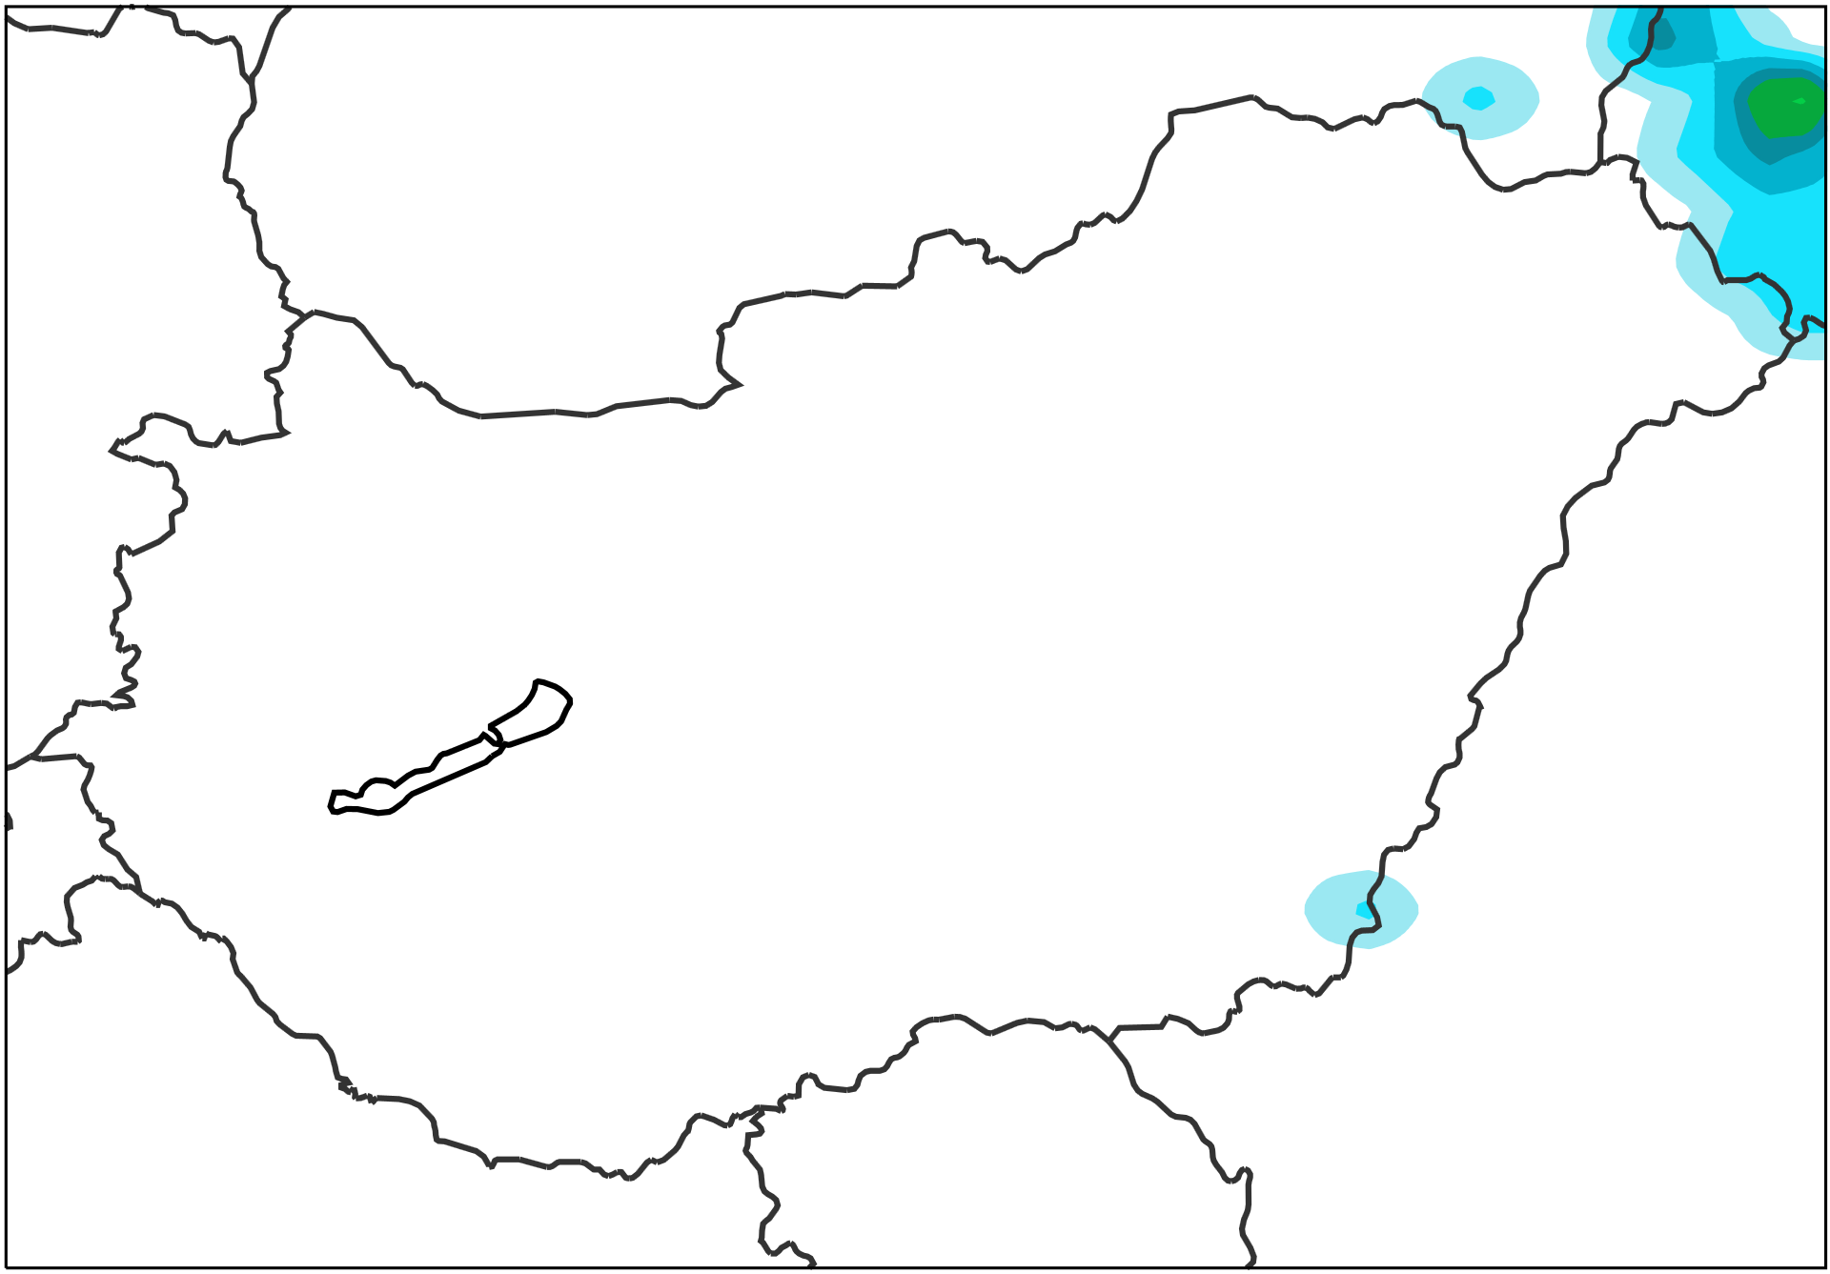
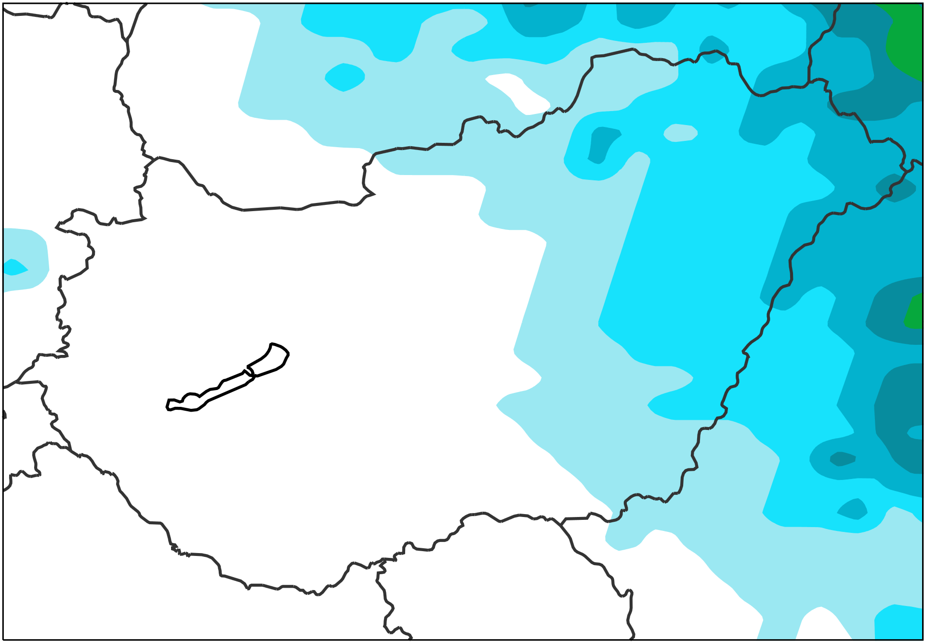
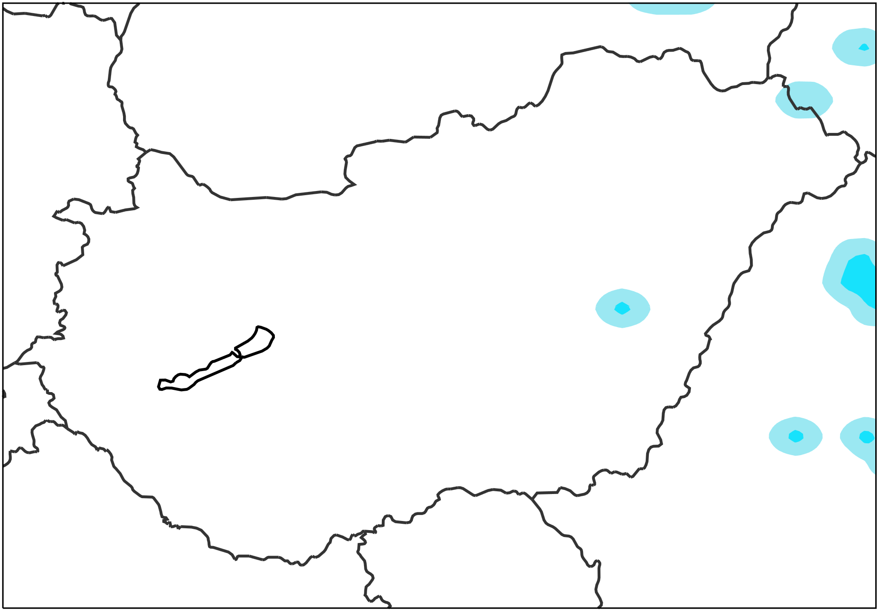
mm / 12h
2018/06/11 0 UTC to 2018/06/11 12 UTC
x
a
ecPoint – Rainfall
Raw ENS
AROME (2.5km, OMSZ)
Would be nice to have.
2018/06/10 00 UTC
(t+24,t+36), DAY 2
[%]
b
f
j
Probabilities of not exceeding 10 mm /12h
Lead time not available for AROME.
2018/06/08 00 UTC
(t+72,t+84), DAY 4
c
g
Would be nice to have.
2018/06/10 00 UTC
(t+24,t+36), DAY 2
d
h
k
Probabilities of not exceeding 30 mm /12h
Lead time not available for AROME.
2018/06/08 00 UTC
(t+72,t+84), DAY 4
e
i

